Slide 1






Clinical EmotiSupport
Interim Presentation
Team Members:
Yuval Reznik, Lior Zvieli, Yoni Libman
December 19, 2025

Slide 2














Project Review
Motivation
Goals
Novelty
Patient messages convey emotional cues intertwined with clinical information
Develop NLP-based system for emotional intensity detection
Emotion intensity prediction (not binary)
Enable emotion-aware clinical workflows
Application to telemedicine messages
Current triage systems overlook emotional signals
Support administrative processes with emotional context
Privacy-safe synthetic data generation
Results in suboptimal prioritization of patient needs
Clinical EmotiSupport - Interim Presentation
2/6

Slide 3


Previous Work
Title / Year | Task | Methods | Data | Results | Relation to Our Project
GoEmotions (2021) [Cited by 1229] | Multi-label emotion detection | BERT-based classifiers | 58K Reddit comments | High multi-label accuracy | Establishes best practices for emotion modeling
ClinicalBERT (2019) [Cited by 1525] | Clinical NLP | Domain-adapted BERT | MIMIC-III notes | Outperforms general BERT | Motivates domain-aware emotion modeling
Emotion Detection in Patient Messages (2020) [Cited by 507] | Healthcare emotion detection | Transformer classifiers | Patient portal messages | Limited by small datasets | Our synthetic data addresses data scarcity
Clinical EmotiSupport - Interim Presentation
3/6

Slide 4









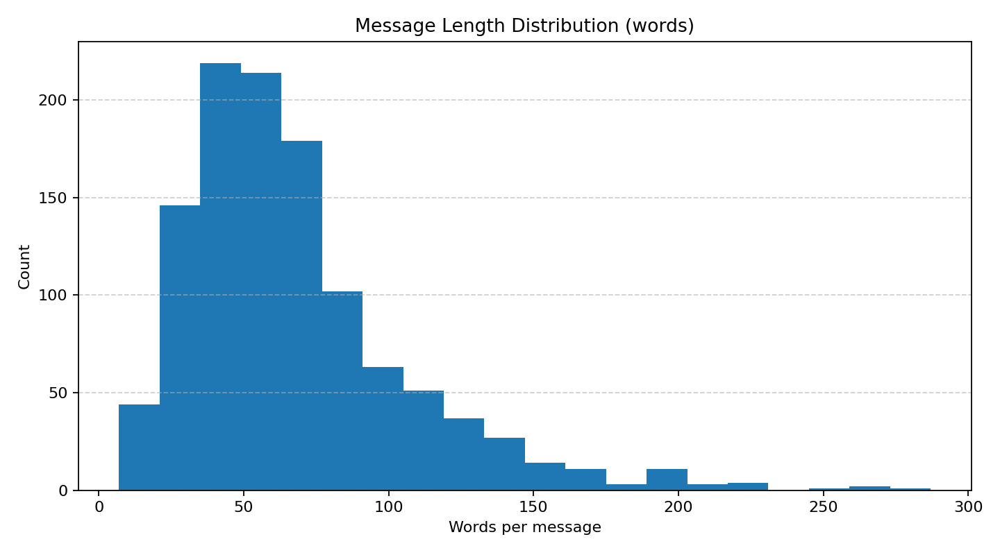
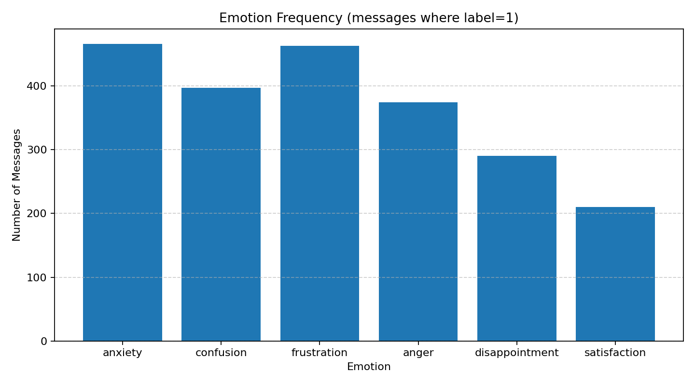




Dataset Overview
Dataset Overview
Message Length (words)
Distribution of Emotions
Samples: N = 1132
Language: English
Domain: Clinical & Administrative(564/568,49.8%/50.2%)
Format: JSONL(one JSON object per line)
Data Generation
Model: DeepSeek-R1:8B
Inference: Ollama
Prompts:
Telemedicine communication (patient/caregiver messages; domains clinical/administrative)
Min / Median / Mean / Max = 7 / 59 / 67.1 / 287
Clinical EmotiSupport - Interim Presentation
4/6

Slide 5













Baseline Solution & Results
Model Architecture
Per-Emotion Analysis
Architecture: DistilBERT
Emotion | Precision | Recall | F1-Score | Support
Anxiety | 0.81 | 0.57 | 0.67 | 74
Confusion | 0.73 | 0.81 | 0.77 | 58
Frustration | 0.94 | 0.82 | 0.87 | 72
Anger | 0.76 | 0.7 | 0.73 | 50
Disappointment | 1.00 | 0.71 | 0.83 | 49
Satisfaction | 0.93 | 0.89 | 0.91 | 28
Task: Multi-label emotion classification
Input: Patient/Caregiver message text
Output: Emotion classification per label (∈ [0,1])
Training: Fine-tuned on synthetic dataset
Overall Metrics
Metric | Precision | Recall | F1-Score
Micro Average | 0.8467 | 0.7341 | 0.7864
Macro Average | 0.8609 | 0.7507 | 0.7971
Evaluation Metrics
Subset Accuracy
Neutral Detection(gate)
Threshold/Neutral threshold
0.4765
P 1.00 R 1.00 (24/170 Neutral)
0.65/0.38
Clinical EmotiSupport - Interim Presentation
5/6

Slide 6


















Project Plan & Next Steps
Dataset Expansion
Label Balancing
Model Upgrade
Generate 500–2000 additional samples
Target rare emotions explicitly
Evaluate ClinicalBERT / RoBERTa
IMPROVED ROBUSTNESS
REDUCED BIAS
HIGHER ACCURACY
Multi-task Learning
Error Analysis
Final Presentation
Joint domain + emotion prediction
Manual inspection of failure cases
Summarize results & insights
BETTER CONTEXTUAL MODELING
IMPROVED INTERPRETABILITY
COURSE SUBMISSION
Clinical EmotiSupport - Interim Presentation
6/6

